Slide 1
PATTERN RECOGNITION
Introduction & Overview
Md. Shamim Hossain
Lecturer, CSE, SU

Slide 2
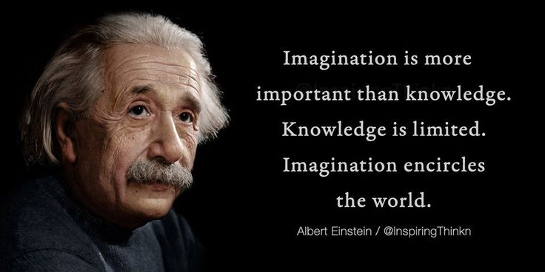

Slide 3
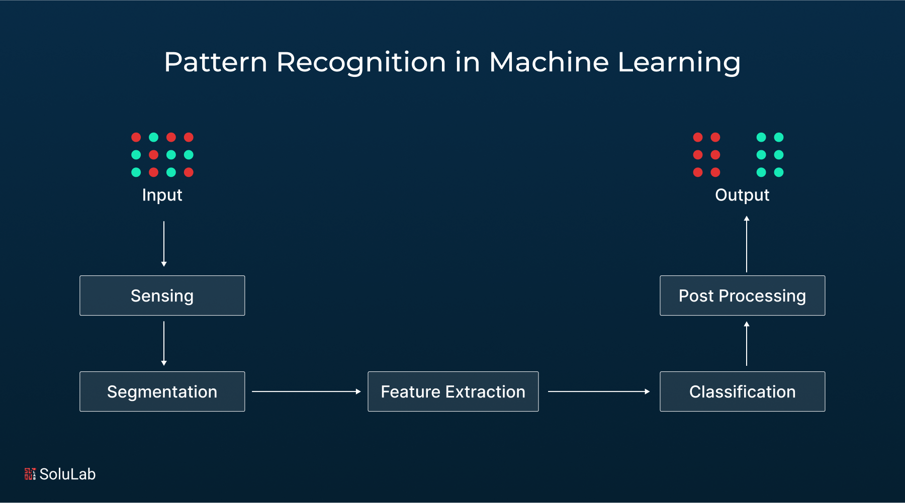
Basic Terminology: ML & PR
Machine Learning: A field of AI where computers learn patterns from data and make decisions without being explicitly programmed.
Dataset: A collection of data used for training and testing a model. Example: Student marks, images, medical records.
Feature: An individual measurable property of data. Example: Age, height, pixel value
Label / Target: The output or correct answer for supervised learning. Example: Pass/Fail, Spam/Not Spam.
Pattern Recognition: Process of identifying patterns and regularities in data.
Pattern: A set of features representing an object. Example: Handwritten digit image.
Feature Vector: A numerical representation of a pattern. Example: [height, width, color]
Decision Boundary: A line or surface separating different classes.
Class: A category to which a pattern belongs. Example: Digits (0–9).
Model: A mathematical representation that learns patterns from data.
Accuracy: Percentage of correct predictions.

Slide 4
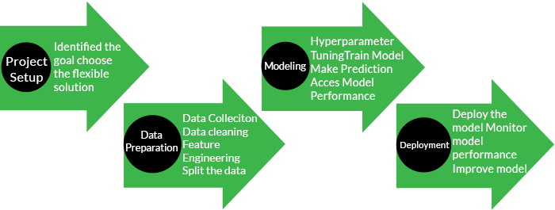
ML & PR: Machine Learning Working Principles
Machine Learning process includes Project Setup, Data Preparation, Modelling and Deployment. The following figure demonstrates the common working process of Machine Learning. It follows some set of steps to do the task; a sequential process of its workflow is as follows:

Slide 5
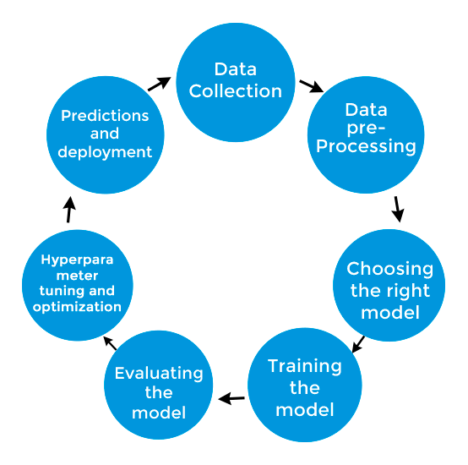
ML & PR: Stages of Machine Learning

Slide 6
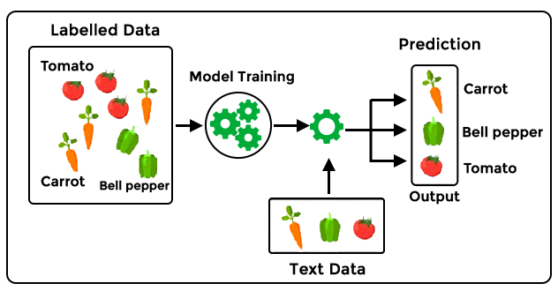
ML & PR: Types of Machine Learning
Machine learning models fall into the following categories:
Supervised Machine Learning − It is a type of machine learning that trains the model using labeled datasets to predict outcomes.

Slide 7
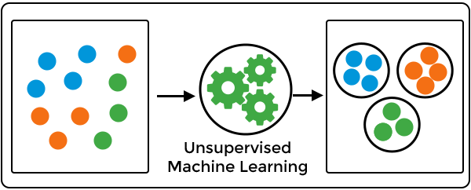
ML & PR: Types of Machine Learning
Unsupervised Machine Learning − It is a type of machine learning that learns patterns and structures within the data without human supervision.

Slide 8
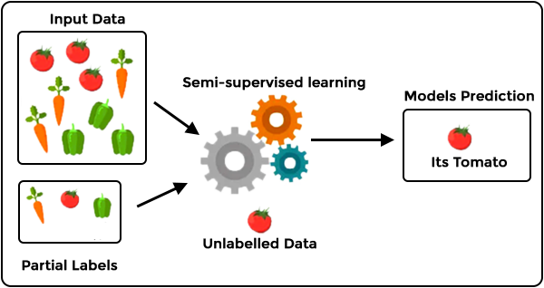
ML & PR: Types of Machine Learning
Semi-supervised Learning − It is a type of machine learning that is neither fully supervised nor fully unsupervised. The semi-supervised learning algorithms basically fall between supervised and unsupervised learning methods.

Slide 9
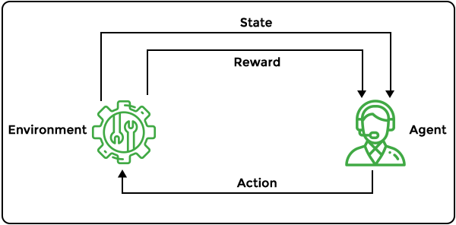
ML & PR: Types of Machine Learning
Reinforcement Machine Learning − It is a type of machine learning model that is similar to supervised learning but does not use sample data to train the algorithm. This model learns by trial and error.

Slide 10
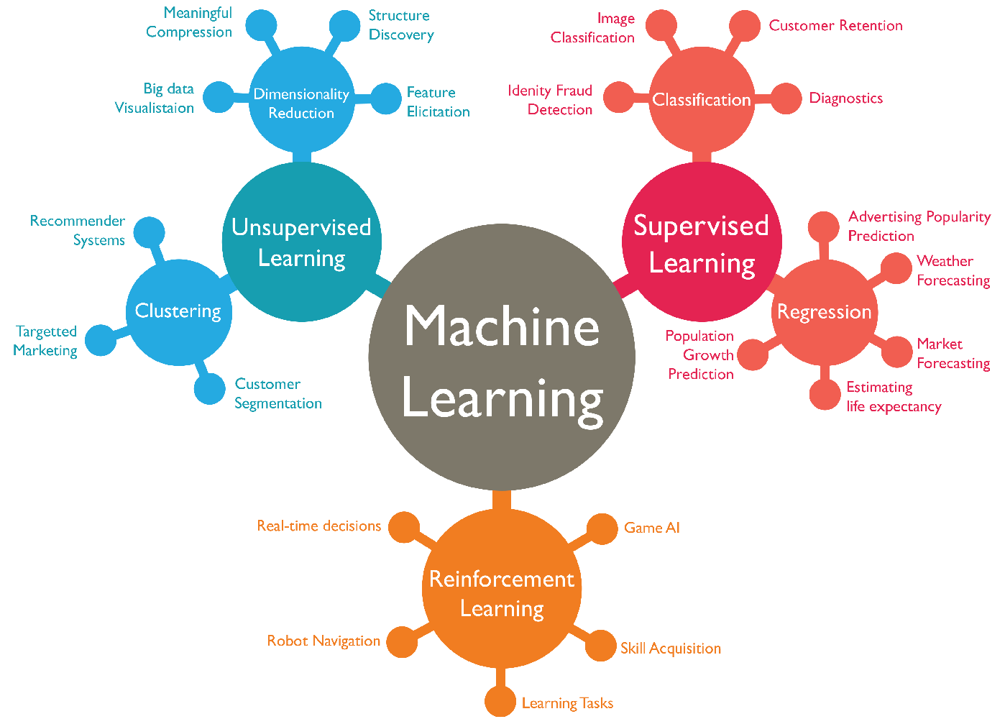
ML & PR: Types of Machine Learning

Slide 11
ML & PR: Importance
Data Processing − Machine learning is useful to analyze large data from social media, sensors, and other sources and help to reveal patterns and insights to improve decision-making.
Data-Driven Insights − Machine learning algorithms find trends and connections in big data that humans might miss, which helps to take better decisions and predictions.
Automation − Machine learning automates the repetitive tasks, reducing errors and saving time.
Personalization − Machine learning is useful to analyze the user preferences to provide personalized recommendations in e-commerce, social media, and streaming services. It helps in many manners, such as to improve user engagement, etc.
Predictive Analytics − Machine learning models use past data to predict future outcomes, which may help for sales forecasts, risk management, and demand planning.
Pattern Recognition − Machine learning is useful in pattern recognition during image processing, speech recognition, and natural language processing.
Finance − Machine learning is used in credit scoring, fraud detection, and algorithmic trading.
Retail − Machine learning helps to enhance the recommendation systems, supply chain management, and customer service.
Fraud Detection & Cybersecurity − Machine learning detects the fraudulent transactions and security threats in real time.
Continuous Improvement − Machine learning models update regularly with new data, which allows them to adapt and improve over time.

Slide 12
ML & PR: Applications
Speech Recognition − Machine learning is used to convert spoken language into text using natural language processing (NLP). It is used in voice assistants like Siri, voice search, and text accessibility features on mobile devices.
Customer Service − There are several chatbots that are useful for reducing human interaction and providing better support on websites and social media, handling FAQs, giving recommendations, and assisting in e-commerce. For example, virtual agents, Facebook Messenger bots, and voice assistants.
Computer Vision − It helps computers in analyzing the images and videos to take action. It is used in social media for photo tagging, in healthcare for medical imaging, and in self-driving cars for navigation.
Recommendation Engines − ML recommendation engines suggest products, movies, or content based on user behavior. Online retailers use them to improve shopping experiences.
Robotic Process Automation (RPA) − RPA uses AI to automate repetitive tasks and reduce manual work.
Automated Stock Trading − AI-driven trading platforms make rapid trades to optimize stock portfolios without human intervention.
Fraud Detection − Machine learning identifies suspicious financial transactions, which help banks to detect fraud and prevent unauthorized activities.

